Slide 1
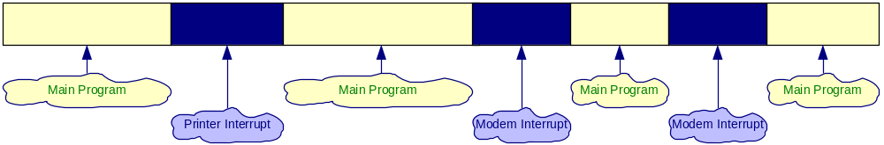
The Purpose of Interrupts
Interrupts are useful when interfacing I/O devices with low data-transfer rates, like a keyboard or a mouse, in which case polling the device wastes valuable processing time
The peripheral interrupts the normal application execution, requesting to send or receive data.
The processor jumps to a special program called Interrupt Service Routine to service the peripheral
After the processor services the peripheral, the execution of the interrupted program continues.

Slide 2
What is interrupt?
When a microprocessor is interrupted, it stops executing its current program and calls a special routine which “services” the interrupt. The event that causes the interruption is called Interrupt and the special routine executed to service the interrupt is called Interrupt Service Routine/Procedure.
Three ways to interrupt the normal program
By external signal
By a special instruction in the program
By the occurrence of some condition

Slide 3
External Signal
An processor can get interrupt from an external signal applied to the NMI pin or INTR pin.
Special instruction
It supports a special instruction, INT to execute special program. At the end of the ISR, execution is usually returned to the interrupt program.
Condition produced by Instruction
An processor is interrupted by some condition produced in the 8086 by the execution of an instruction.
Example : Divide by Zero
Program execution will automatically be interrupted if you attempt to divide an operand by zero.
ACOE255

Slide 4
Interrupt types
  Hardware Interrupts:
  An interrupt caused by an external signal (External event )
  Software Interrupts:
  Conditional interrupt or interrupts caused by special instruction Internal event (Software generated)
  Maskable and Non- maskable interrupts
  Interrupt priority
Interrupt Vectors and Interrupt Handlers
Interrupt Controllers

Slide 5
BASIC INTERRUPT TERMINOLOGY
Interrupt pins: Set of pins used in hardware interrupts
Interrupt Service Routine (ISR) or Interrupt handler: code used for handling a specific interrupt
Interrupt priority: In systems with more than one interrupt inputs, some interrupts have a higher priority than other
  They are serviced first if multiple interrupts are triggered simultaneously
Interrupt vector: Code loaded on the bus by the interrupting device that contains the Address (segment and offset) of specific interrupt service routine
Interrupt Masking: Ignoring (disabling) an interrupt
Non-Maskable Interrupt: Interrupt that cannot be ignored (power-down)

Slide 6
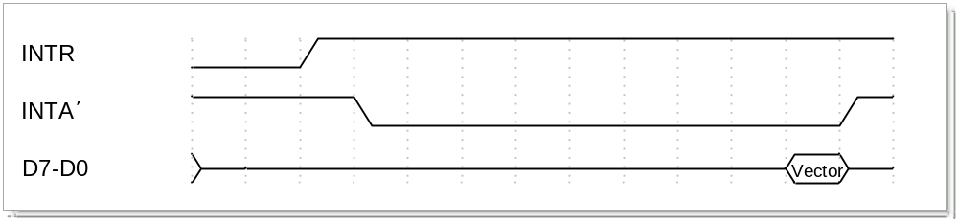
Hardware Interrupts – Interrupt pins and timing
Interrupt Pins
  INTR: Interrupt Request. Activated by a peripheral device to interrupt the processor.
    Level triggered. Activated with a logic 1.
  INTA: Interrupt Acknowledge. Activated by the processor to inform the interrupting device the the interrupt request (INTR) is accepted.
    Level triggered. Activated with a logic 0.
  NMI: Non-Maskable Interrupt. Used for major system faults such as parity errors and power failures.
    Edge triggered. Activated with a positive edge (0 to 1) transition.
    Must remain at logic 1, until it is accepted by the processor.
    Before the 0 to 1 transition, NMI must be at logic 0 for at least 2 clock cycles.
    No need for interrupt acknowledgement.

Slide 7
Interrupt Vectors
The processor uses the interrupt vector to determine the address of the ISR of the interrupting device.
In the 8088/8086 processor as well as in the 80386/80486/Pentium processors operating in Real Mode (16-bit operation), the interrupt vector is a pointer to the Interrupt Vector Table.
  The Interrupt Vector Table occupies the address range from 00000H to 003FFH (the first 1024 bytes in the memory map).
  Each entry in the Interrupt Vector Table is 4 bytes long:
    The first two represent the offset address and the last two the segment address of the ISR.
  The first 5 vectors are reserved by Intel to be used by the processor.
    The vectors 5 to 255 are free to be used by the user.

Slide 8
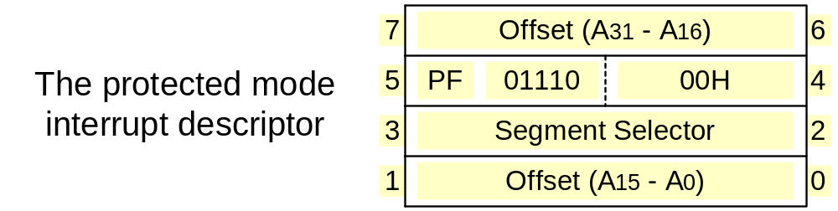
The Intel x86 Vector Interrupts:- Protected Mode (32-bit)
In the 80386/80486/Pentium processors operating in the Protected Mode (32-bit operation), the interrupt vector is a pointer to the Interrupt Descriptor Table.
  The Interrupt Descriptor Table can be located anywhere in the memory.
    Its starting address is pointed by the Interrupt Descriptor Table Register (IDTR).
  Each entry in the Interrupt Vector Table is 8 bytes long:
    Four bytes represent the 32-bit offset address, two the segment selector and the rest information such as the privilege level.
  The first 32 vectors are reserved by Intel to be used by the processor.
    The vectors 33 to 255 are free to be used by the user.

Slide 9
INTERRUPT & ISR ?
‘Interrupts’ is to break the sequence of operation.
While the CPU is executing a program, on ‘interrupt’ breaks the normal sequence of execution of instructions, diverts its execution to some other program called Interrupt Service Routine (ISR)

Slide 10
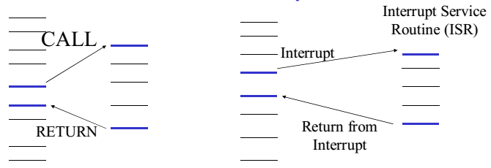

Slide 11
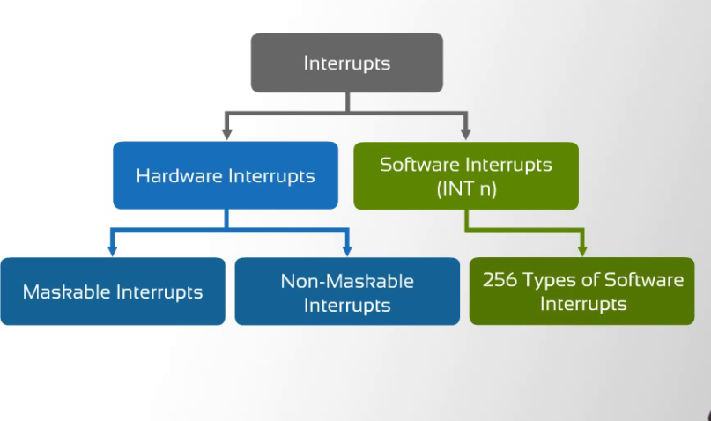

Slide 12
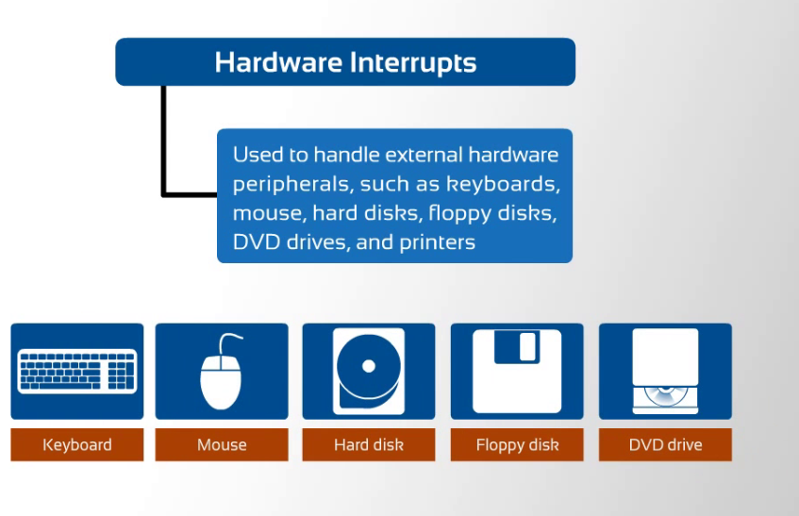

Slide 13
Maskable Interrupt: An Interrupt that can be disabled or ignored by the instructions of CPU are called as Maskable Interrupt.
Non- Maskable Interrupt: An interrupt that cannot be disabled or ignored by the instructions of CPU are called as Non- Maskable Interrupt.
Software interrupts are machine instructions that amount to a call to the designated interrupt subroutine, usually identified by interrupt number. Ex: INT0 - INT255

Slide 14
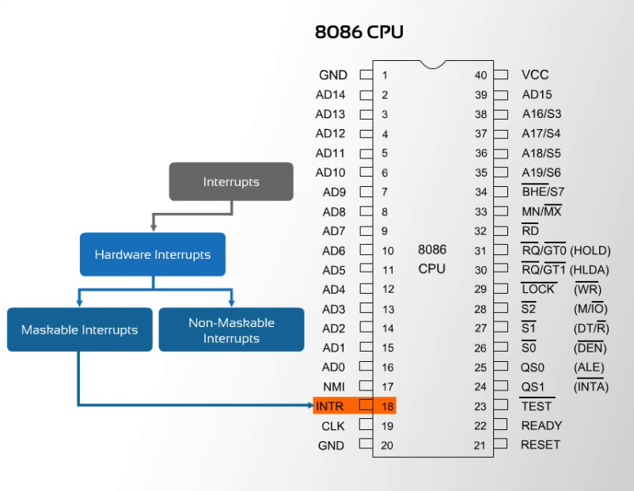

Slide 15


Slide 17
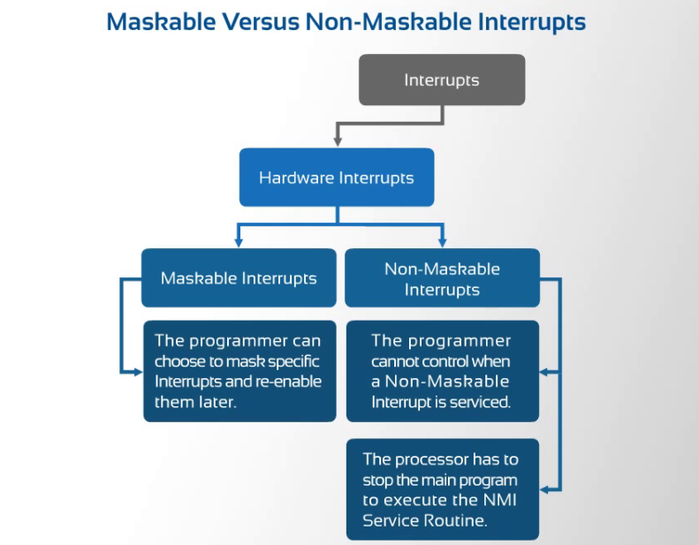

Slide 18
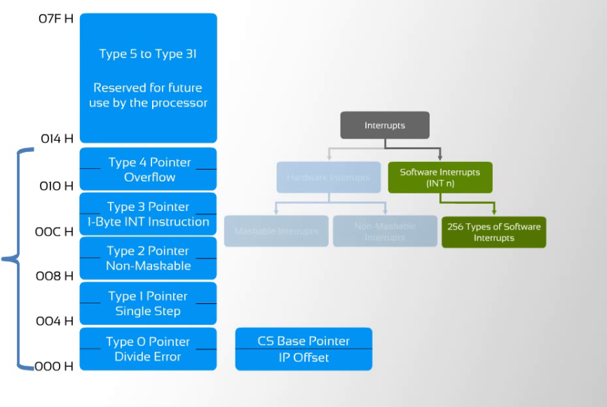

Slide 19
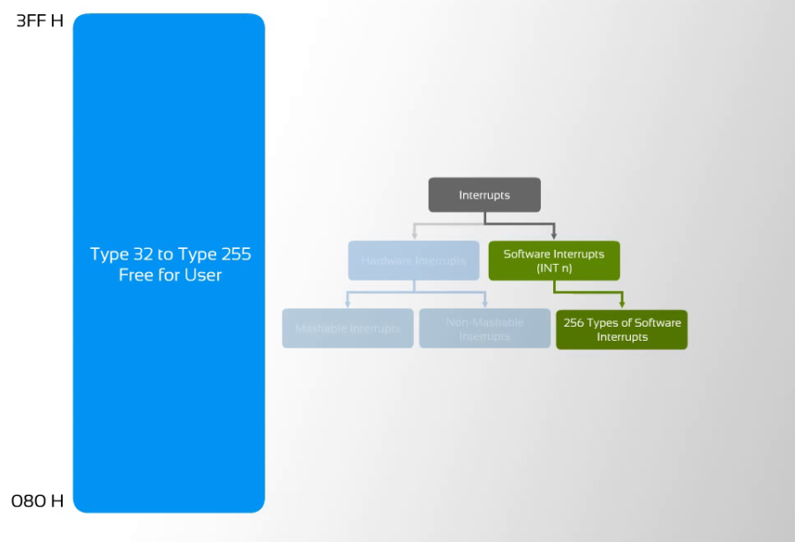

Slide 20
INTERRUPT VECTOR TABLE
256 INTERRUPTS OF 8086 ARE DIVIDED IN TO 3 GROUPS
TYPE 0 TO TYPE 4 INTERRUPTS-
These Are Used For Fixed Operations And Hence Are Called Dedicated Interrupts
TYPE 5 TO TYPE 31 INTERRUPTS
Not Used By 8086,reserved For Higher Processors Like 80286
80386 Etc
TYPE 32 TO 255 INTERRUPTS
Available For User, called User Defined Interrupts These Can Be H/W Interrupts And Activated Through Intr Line Or Can Be S/W Interrupts.

Slide 21
Type – 0 Divide Error Interrupt
Quotient is too large cant be fit in AL/AX or Divide By Zero {AX/0=∞}
Type –1 Single Step Interrupt
used for executing the program in single step mode by setting Trap Flag
To Set Trap Flag PUSHF
MOV BP,SP
OR [BP+0],0100H;SET BIT8
POPF
Type – 2 Non Maskable Interrupt
    This Interrupt is used for executing ISR of NMI Pin (Positive Egde Signal). NMI cant be masked by S/W
Type – 3 Break Point Interrupt
used for providing BREAK POINTS in the program
Type – 4 Over Flow Interrupt
used to handle any Overflow Error after signed arithmetic

Slide 22
PRIORITY OF INTERRUPTS
Interrupt Type | Priority
INT0, INT3-INT 255, | Highest
NMI(INT2)
INTR
SINGLE STEP | Lowest

Slide 23
TYPES OF INTERRUPTS
Divide by Zero Interrupt (Type 0)
- When the quotient from either a DIV or IDIV instruction is too large to fit in the result register, 8086 will automatically execute type 0 interrupt.
Single step interrupt (Type 1)
- In this mode, system will execute one instruction and wait for further direction from user.
- Then user can examine the content of registers and memory locations and if they correct, user can tell the system to execute the next instruction.
- This feature is useful for debugging ALP. (TF=1 auto Execution)
Non-Maskable Interrupt (Type 2)
-This interrupt cannot be disabled by any software instruction.
- Activated by NMI pin of processor.

Slide 24
Breakpoint Interrupt (Type 3)
- It is used to implement break point function in the system.
- It follows the break point procedure after insert the break point in program.
- Breakpoint procedure :
To display the register contents, memory contents and other information that is required to debug the program.
Overflow Interrupt (Type 4)
- It is used to check overflow condition after any signed arithmetic operation in the system.
-OF flag will be represented in the destination register or memory location.

Slide 25
Maskable Interrupt
- It is provided with a maskable handshake interrupt.
- It is implemented by two pins
INTR and INTA
- It can be enabled or disabled by STI (IF=1) or CLI (IF=0)
Software Interrupts
- INT can be used to cause the processor to do one of the 256 possible interrupts
- The interrupt type specified by the number as a part of the instruction.
- With the software interrupts can call the desired routines from many different program in the system.
Example : BIOS(Basic input output system) in IBM PC
- Interrupt processing flow as follows,

Slide 26
Interrupt processing flow
1. External interface sends an interrupt signal, to the Interrupt Request (INTR) pin, (or an internal interrupt occurs.)
2. The CPU finishes the present instruction (for a hardware interrupt) and checks the INTR pin. If IF=0 the processor ignores the interrupt, else sends Interrupt Acknowledge (INTA) to hardware interface.
3. The interrupt type N is sent to the Central Processor Unit (CPU) via the Data bus from the hardware interface.
4. The contents of the flag registers are pushed onto the stack.
5. Both the interrupt (IF – FR bit 9) and (TF – FR bit 8) flags are cleared. This disables the INTR pin and the trap or single-step feature.

Slide 27
6. The contents of the code segment register (CS) are pushed onto the Stack.
7. The contents of the instruction pointer (IP) are pushed onto the Stack.
8. The interrupt vector contents are fetched, from (4 x N) and then placed into the IP and from (4 x N +2) into the CS so that the next instruction executes at the interrupt service procedure addressed by the interrupt vector.
9. While returning from the interrupt-service routine by the Interrupt Return (IRET) instruction, the IP, CS and Flag registers are popped from the Stack and return to their state prior to the interrupt.

